Slide 1
T H E C O M P L E T E W O R L D O F E D U C A T I O N
Recognised under the senion 2 (g of the UGC Act 1956
) the Youth; Empowering the Nation

Slide 2


Library Management System
Second Year Project Synopsis Submitted by
ROLL | NAME
2301010418 | Karan Lal Shah
2301010434 | Sahil Chauhan
Industry Mentor:Dr. Helaluddin Faculty Mentor: Vishwanil Suman

Slide 3

Project Overview
Brief Overview of the Topic:
Automation: The system automates core library tasks like book issue/return, record management, and member tracking.
Efficiency: Reduces manual errors and speeds up library operations with a user-friendly interface.
Centralized Management: Offers a centralized platform to manage books, users, and transactions securely and efficiently.

Slide 4
About the Problem
Problems Identified
Manual Record Keeping: Traditional libraries rely on paperwork, which is time-consuming and prone to errors.
Difficulty in Tracking Books: Locating issued, returned, or lost books manually can be inefficient.
No Real-Time Updates: Manual systems lack instant updates on book availability and user activity.
Limited Accessibility: Physical registers can only be accessed on-site, making remote access or data backup difficult.

Slide 5
Problem Statement
Problem Definition:
Traditional library systems rely heavily on manual processes for managing book inventories, user records, and transactions, leading to inefficiencies, errors, and data loss.
Why It’s Important:
Efficient library management is crucial for educational institutions to ensure smooth access to resources, accurate tracking of books, and time-saving processes for both students and staff.
Expected Impact:
Implementing a digital system will streamline operations, reduce human error, provide real-time updates, and enhance user experience through faster, more reliable services.

Slide 6
Objectives
To automate the process of managing books, users, and transactions in a library environment.
To ensure accuracy in book records, issue/return history, and availability status.
To provide a user-friendly interface for both admin and users for easy navigation and operations.
To maintain a secure and centralized database for all library-related information.

Slide 7
Methodology, Tools, and Techniques
Approach taken to solve the problem
Identified the core functions needed: book management, user management, issue/return system, and admin control.
Studied existing systems and user expectations to design an efficient solution.Encrypted database to prevent vote tampering.
Designed a simple and intuitive UI for both users and admins.
Tools & Technologies Used:
Frontend: HTML, CSS & Javascripts
Backend: Java (Spring Boot) / Node.js
Database: MySQL / MongoDB
Security Measures: AES encryption, blockchain ledger for vote integrity
Hosting & Deployment: AWS / Firebase

Slide 8

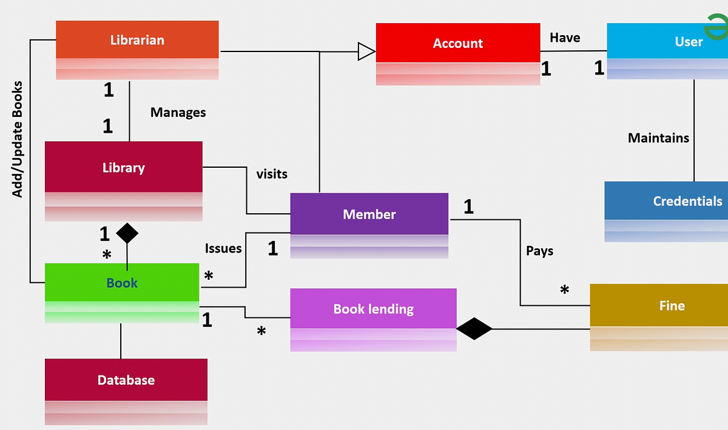
Methodology Flowchart

Slide 9

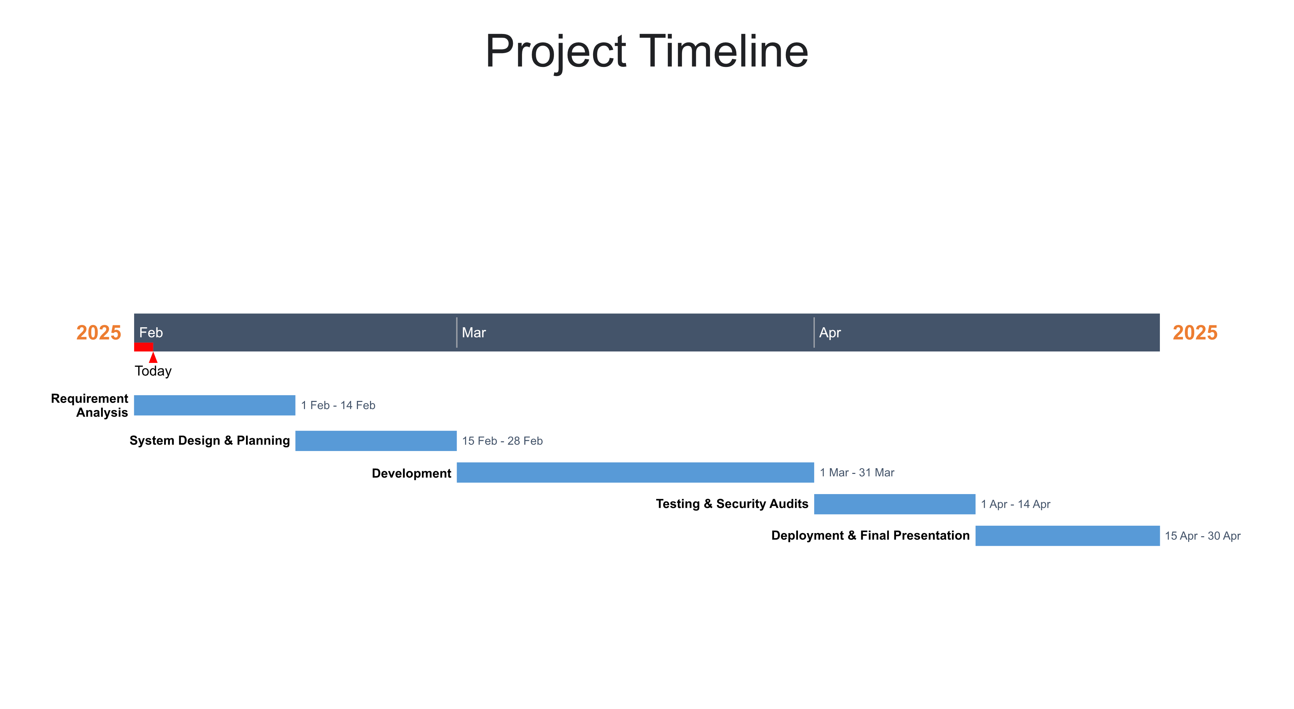
Project Timeline

Slide 10
Expected Results & Impact
Expected Results:
Significant reduction in time and effort required to manage books, users, and transactions.
Reliable tracking of book availability, issue/return history, and user activities with minimal errors.
Easy-to-use interface that simplifies interaction for both admin and students.
Impact:
Automates routine tasks like book issue/return, reducing workload for library staff and improving efficiency.
Reduces the need for manual work and paperwork, saving administrative time and minimizing operational costs.
Promotes a digital-first mindset on campus, aligning with smart education goals and enhancing the institution’s image.

Slide 11
References
TutorialsPoint – Library Management System in PHP: A comprehensive guide to building an LMS in PHP.
GeeksforGeeks – Library Management System in Java: Code examples for building an LMS in Java.
Koha: An open-source library management system, offering a fully-featured solution.
PMB (PhpMyBibli): Open-source library management system built with PHP and MySQL.
OpenBiblio: Another open-source LMS to reference for features and architecture.

Slide 12

THANK YOU

